Slide 1


An Analysis on
Social Buzz’s
Contents
Notes:
Hello and welcome, my name is Divine Jude, today I will be presenting to you the results of the Data Analytics task.

Slide 2


Today's agenda
Project recap
Problem
The Analytics team
Process
Insights
Summary
Notes:
Today's agenda will be as follows:
1. We will recap the overall project to give a high level understanding of the business problem we're tackling and the specific requirements.
2. We will dive into the specific problem that we, the Data Analytics team, have been focusing on and will give some background as to why this is such a big problem.
3. After introducing the problem, I will go over the team responsible from our side in tackling this task.
4. I will then go over the high-level process that we followed to complete this task, so that you have complete clarity in how we tackle these kinds of tasks.
5. Finally, I will go over the all important results and I will present them as a series of insights and visualization's from our analysis.
To wrap up, I will summarize and be open for any questions.

Slide 3


Social Buzz is a social media and content creation company founded in 2010 by two former engineers. They have a unique approach to content, keeping all users anonymous and tracking user reactions on every piece of content. They have rapidly grown to over 500 million active users each month, and are now looking to bring in external expertise to help them complete an IPO by the end of next year, manage their scaling process effectively, and learn data best practices from a large corporation.
Our engagement with Social Buzz will include a 3 month initial project, where we will:
Conduct an audit of their big data practice,
Make recommendations for a successful IPO, and
Analyse their content categories to highlight the top 5 categories with the largest aggregate popularity.
Project Recap
Notes:
To kick things off let me recap this engagement.
We, Accenture have embarked on a 3 month pilot with Social Buzz to focus on 3 main tasks, aligned with some of the biggest challenges that you're currently facing.
Social Buzz has reached huge scale in recent years to become recognized as a global unicorn company. We are here to help you manage this scale and to guide you in the right direction.
Firstly, we will be doing an audit of your big data practice and sharing best practices and industry expertise. Secondly we will be guiding you through a successful IPO, of which we have deep expertise and knowledge of within our team.
And finally, we have conducted an analysis of your data to find insights regarding your top 5 most popular categories of content

Slide 4


Problem
Due to the rapid growth and digital nature of Social Buzz’s core product, the amount of data that they create, collect and must analyze is huge. Every day over 100,000 pieces of content and 36,500,000 pieces of content per year, ranging from text, images, videos and GIFs are posted. All of these constitute highly unstructured data that requires expertise in handling. The client has reached a massive scale within recent years and does not have the resources internally to handle it.
Notes:
Focusing on the last point that I mentioned there, this is what the Data Analytics team has been specifically focused on.
Clearly with such grand scale, this comes with a lot of data and with such vast amounts of data comes challenges.
To give a background on how much data you've been creating:
You told us that your platform receives over 100000 posts per day which amounts to 36 500 000 posts every year, of which, this is all unstructured data making it very hard to make sense of.
In this day and age, content is king. Just look at some of the biggest platforms in the world, for example YouTube, Facebook and Netflix... they are all content businesses...
But how to capitalize on it when there is so much?
It's not just all about harvesting as much content as possible... The real value is in understanding and crunching this content to gain a deeper understanding of your audience and to therefore provide a more personalized and enjoyable experience.
And this is where out data analytics expertise comes in, with the insights that we've uncovered from this task, we can show you exactly how to take analytics to production at scale.

Slide 5



ANDREW FLEMING
Chief Technology Architect
The Analytics team
MARCUS ROMPTON
Senior Principal
DIVINE JUDE (ME)
Data Analyst
Notes:
Talking about experience, we have a large data analytics practice at Accenture but we had a team of 3 people primarily focusing on this task.
Andrew Fleming is our Chief Technical Architect and his expertise really helped to guide the
team to produce high quality analysis.
Marcus Rompton, a senior principal has worked with the worlds biggest clients on solving their data problems and was heavily involved in the data engineering side of this project.
And finally myself, Divine Jude, who was solely responsible for taking leadership guidance and delivering high quality insights from the raw datasets and turning these into business decisions.

Slide 6

Data Understanding
Process
1
2
Data Extraction
3
Data Modelling
4
Data Analysis
5
Recommendations
Notes:
How did we tackle this problem?
Well we approached it in 5 steps:
Data Understanding: Understand the data model and domain of your business
Data Extraction: Architected what an ideal dataset should look like for this problem and extracted it from the relevant data sources
Data Modelling: Process and model the data into a dataset that can precisely answer the business questions and produce analytics.
Data Analysis: Use analytical expertise to uncover insights from the dataset and to produce visualizations to describe the insights.
Recommendations: Use insights to unlock business decisions and make recommendations on next steps

Slide 7


Insights
16
1897
Photos
Animal Posts
Content type with
Most engagement
Unique Content Categories
Notes:
From your data we found that:
A total of 16 unique categories of posts across your sample dataset. This includes things such as Animals, science, healthy eating, technology, food, culture, travel, cooking, soccer, education, fitness, Studying, dogs, tennis, veganism, public speaking.
There were 1897 reactions from just the animal category alone.
And also the most common content type for users to post within was Photos. This could be due to the visual nature of photos which can be more attention grabbing and easier to understand compared to Gif, video and audio.
But now, onto the main question... which is... what were the top 5 most popular categories of posts?

Slide 8
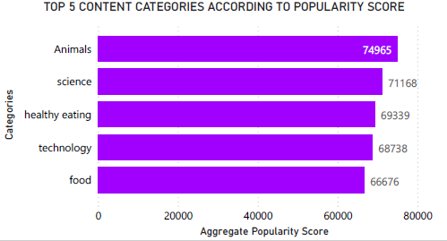
From our analysis you can see the top 5 most popular contents were Animals, Science, Healthy Eating, Technology, Food in descending order. Animals had an aggregate popularity score of around 74965. This data suggests that users are particularly interested in content related to animals, science, and healthy eating, with technology and food also being popular topics.
Notes:
From our analysis you can see the top 5 most popular contents were Animals, Science, Healthy Eating, Technology, Food in descending order. Animals had an aggregate popularity score of around 74965. This data suggests that users are particularly interested in content related to animals, science, and healthy eating, with technology and food also being popular topics.
Animals and science are broad categories that can encompass a wide range of subtopics, from cute animal videos and photos to scientific research and discoveries. Healthy Eating is another broad category that may include information about nutrition, diet, and wellness.
Technology is a broad and dynamic category that can include a wide range of topics, from the latest smartphones and laptops to cutting-edge research in fields like artificial intelligence and quantum computing. Food is another broad category that can encompass everything from recipes and cooking tips to restaurant reviews and food-related news.
It's worth noting that these are just general trends, and it's important to consider the specific interests of your target audience ensuring that this content are opposed to individual users at the forefront of user feeds.

Slide 9
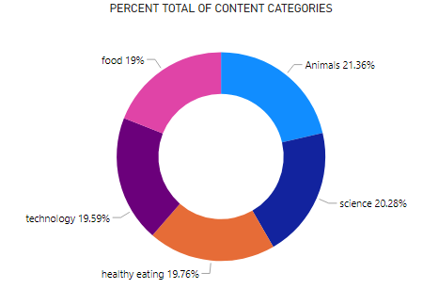
Notes:
Additionally, you can see from this chart the % split of popularity between the top 5 categories. There is not much difference between the share of each category, however, the difference between the 1st most popular, animals and the 2nd most popular, science, is the largest gap equal to 1.1%.
In business terms, this could suggest that the most popular category, animals, is tailing away from the rest of the categories and may continue to get more and more popular. To avoid an issue where 1 content category consumes the entire platform, it will be important for you to ensure that any algorithms used to govern the content on the platform gives a fair balance to the content categories.

Slide 10
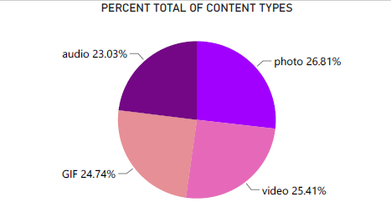
For the content types, Photo is the most favored content type. This could indicate that users engage with photos more frequently and for longer periods of time compared to other types of content. This could be due to the visual nature of photos, which can be more attention-grabbing and easier to understand than audio or video.
Notes:
Photos can often convey a message or emotion more effectively than text alone. It's worth noting that there are many factors that can influence user engagement with different types of content, and further research would be needed to fully understand the reasons behind users' preferences.

Slide 11
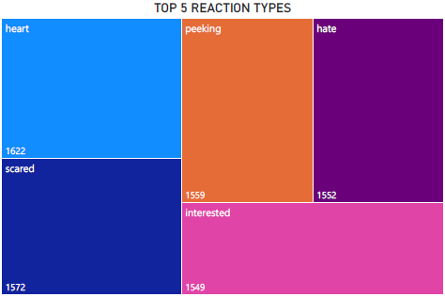
Additionally, from our analysis the top 5 content reactions were heart, scared, peeking, hate, interested this could convey that users tend to have strong emotional reactions to the content they are viewing. The heart reaction suggests that users find the content to be positive and likable, while the scared and peeking reactions may indicate that the content is suspenseful or intriguing. The hate reaction suggests that users have a negative reaction to the content, and the interested reaction suggests that users are paying attention and engaged with the content.
Notes:
These emotions could be used as an indicator of the type of content and audience that is resonating with your user base. For example, if a majority of your users are responding with heart reactions, it could indicate that your content is generally positive and well-received. If a majority of users are responding with hate reactions, it could indicate that content may be controversial or polarizing.

Slide 12


ANALYSIS
Animals and science are broad categories that can encompass a wide range of subtopics, from cute animal photos and videos to scientific research and discoveries.
INSIGHTS
Summary
We also found that food was a common theme amongst popular content and the most popular food category was healthy eating. This could be a signal to show the types of people that are using your platform, and you could use this insight to boost engagement even further. For example, you could run a campaign with content focused on this category or work with healthy eating brands to promote content.
Notes:
So to summarize:
We tackled this task and found the top 5 most popular categories as asked, but we also went one step further.
- We found that animals and science are the two most popular categories,
suggesting that users like "real-life" and "factual" content.
- We also found that food was a common theme amongst popular content and
the most popular food category was healthy eating. This could be a signal to
show the types of people that are using your platform, and you could use this
insight to boost engagement even further. For example, you could run a
campaign with content focused on this category or work with healthy eating
brands to promote content.
It's worth noting that these are just general trends, and it's important to consider the specific interests of your target audience ensuring that content are opposed to individual users at the forefront of user feeds.

Slide 13


NEXT STEP
Social Buzz can leverage this information to
better understand their audience optimize their content strategy and to drive growth on their platform.
Based on the valuable insights obtained from this ad-hoc analysis, Social Buzz should consider partnering with Accenture to expand this analysis on a larger scale for real-time understanding of the business and to deliver even more value
Notes:
- As much as this analysis was insightful, we are ready to take it to the next stage and we have the expertise within Accenture to help you realize these kinds of insights in production across your organization and in real-time. We would love to help you with this.

Slide 14

Thank you!
ANY QUESTIONS?
Notes:
Thank you very much for listening, please feel free to ask any questions that you may have!

